Slide 1
Year 2 Information Night
Ms Karli Burns – Team Leader
Mrs Kim Moucha
Mrs Andrea Cleeve
Mrs Nat Carr
Mrs Fiona Wright
Thursday, February 8th 2018

Slide 2
Welcome Parents & Guardians
Overview of Presentation
Literacy
Numeracy
Inquiry
Homework
Specialists Programs
Behavioural Expectations
Rubbish Free School
Dates to Remember
Question Time

Slide 3
literacy
READING
The classroom reading program is underpinned by John Munro’s 7 High Reliability Literacy Teaching Procedures (7HRLTP’s):
1. Get your knowledge ready
2. Vocabulary
3. Reading aloud
4. Paraphrasing and visualising
5. Asking questions relevant to the text
6. Summarising
7. Reviewing

Slide 4
literacy
WRITING
VCOP is a program that gives students the skills to improve their writing in all areas of learning.
V- Vocabulary
C- Connectives
O- Openers
P- Punctuation
Throughout Term 1 students will focus primarily on:
- Recounts: journal writing
- Narratives: story writing
- Punctuation: capital letters and full stops
- Grammar: nouns, verbs and adjectives
- Handwriting: correct letter formation

Slide 5
literacy
SPEAKING AND LISTENING
Oral language is embedded in all Literacy activities
Practise speaking and listening skills on a daily basis during Share Time
Teachers plan for rich oral language based activities and use higher order thinking when questioning

Slide 6
literacy
SPELLING
Words Their Way
Oxford Wordlist
Weekly Spelling Focus

Slide 7
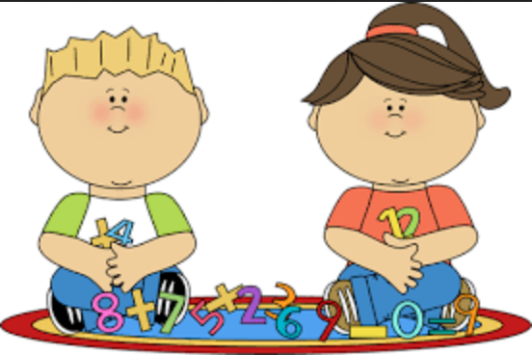
Numeracy
All Numeracy lessons implement a teaching and learning model created by Michael Ymer, which values the use of the following when developing an understanding of basic Numeracy concepts:
- 10 minutes of Number Fluency Tasks
- Open ended, hands on tasks
- Concrete materials
- Develop solid understandings of Number

Slide 8
Numeracy
Lessons follow a common structure:
- 10 minutes Number Fluency Tasks
- 10 minutes explain, model and make links
- 25 explore activities. Teacher working with small groups or individual students
- 5 mins summarise, review, share
Lesson intent is stated clearly so students know what they are learning and what is expected of them.

Slide 9
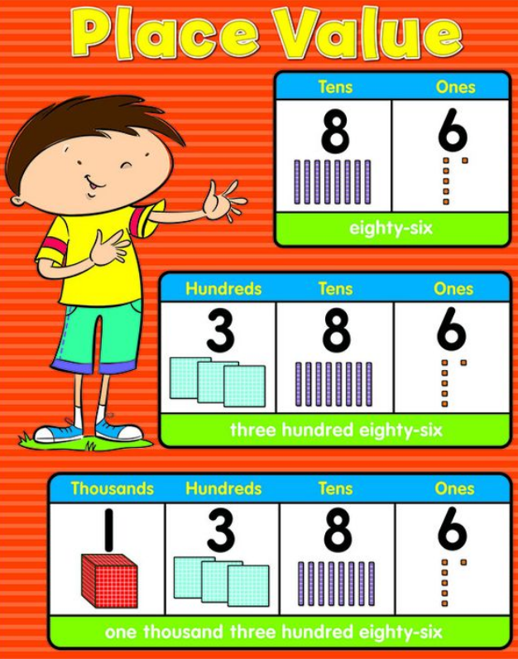
Numeracy
In Term 1 children will focus on:
Number: Numbers to 1000, Place Value, skip counting, counting forwards and backwards and number patterns.
Measurement: Days of the week, months of the year and calendars.
Data: Gathering and analysing data.

Slide 10
Inquiry
Viewbank Primary School have adapted an Inquiry approach to student learning,
particularly when teaching Geography, History, Design & Technology, Creative & Critical Thinking, Science and Personal & Social Capabilities.
Inquiry Units are developed by asking students to generate questions about a concept within the Victorian Curriculum. Teachers then use students’ questions together with the curriculum to develop a set of key understandings for each Inquiry. Each Inquiry is planned according to student interest and may run across more than one school term.
The structure of all Inquiry Units are as follows…

Slide 11
Tuning In To gauge prior knowledge, immerse students in the inquiry and for students to pose questions for investigation Finding Out To collect information Sorting Out To organise, represent and present collected data Going Further To broaden and extend the unit if appropriate Reflection To reflect on what they have learnt (understandings) and the process of learning (skills and dispositions) Action To apply or act on what has been learnt

Slide 12
Inquiry In Term 1
Our key understandings in Term 1 are:
There are similarities and differences between lifestyles in the past and now
In the past the land was used and valued in different ways
We would love parent and community involvement in all of our Inquiry Units, so please keep an eye out on Compass for Newsfeed Items and Events.

Slide 13
Homework
In Year 2 Students are expected to complete the following activities for homework.
Mathletics
Each week students will be given set Mathletics tasks related to the content being taught in class at the time. Students are expected to complete these each week and the teacher will follow students’ progress online.
Talk Homework
Students will also receive writing topics to discuss with parents/guardians and family the night before a Big Write.

Slide 14
Homework
Home Reading
Home Reading is designed for easy and enjoyable reading for the child. Students select a book each day from their allocated book box in the classroom. Parents should listen to their child read every night and encourage discussion about the text. Students will be sent home with a ‘reading strategies and comprehension bookmark’. Please use this to help guide text discussions.

Slide 15
Share Time
Every fortnight students will prepare a short speech to present to their classmates during Share Time. These presentations will be on a specific topic relating to the Inquiry Unit.

Slide 16
Specialist programs
*P.E – 45 minutes each week
*Japanese – 45 minutes each week
*Art – 90 minutes each week (Semester 1)
*Science – 90 minutes each fortnight
*Music – 90 minutes each fortnight (Semester 2)
*ICT – is now taught by the classroom teacher
*Library – 30 minutes each week (classroom teachers)

Slide 17
Behavioural expectations
*Everyone has the right to feel safe
*Everyone has the right to learn
*Everyone has the right to be treated with respect
Commitment to our School Values
*Respect
*Responsibility
*Doing your best
*Honesty
*Trustworthiness

Slide 18
Behavioural expectations
Classroom Expectations
Classroom expectations are negotiated in each classroom through brainstorming of ideas, discussion, reasoning and past experiences as well as knowledge of School Values.
Positive behaviours are regularly acknowledged in the classroom and at the whole school level (Citizen of the Month and Weekly Student Awards).

Slide 19
Rubbish Free School
A note from our Sustainability Team:
We want to reduce the amount of rubbish in the yard.
Please send your children to school with their recess and lunch food in recyclable or reusable packaging.
Students will have eating time in class.
For any reusable packaging that they take outside, each grade has a tub located near the door to store their belongings in.
All rubbish that does come to school, must go in the bin before they leave.
Students who need to take rubbish outside (e.g. yoghurt containers) can only eat in the middle court yard.

Slide 20
Dates to Remember
Mon 12th Feb Share Time Starts
Tue 13th Feb School Photos
Tue 13th Feb Getting to Know You Interviews
Thur 15th Feb Getting to Know You Interviews
Fri 16th Feb Take Home Reading Starts
Mon 26th Feb Homework Starts (due every Friday)
Mon 12th Mar Labour Day (Public Holiday)
Fri 16th Mar Community Movie Night
^{Wed 21st Mar Harmony Day}
Thur 29th Mar Last Day of School (2:30 dismissal)
Fri 30th Mar Good Friday (Public Holiday)

Slide 21
Questions
Thank you for your attendance tonight.
Please come and see one of the Year 2 teachers if you have any further questions. ☺

